Slide 1
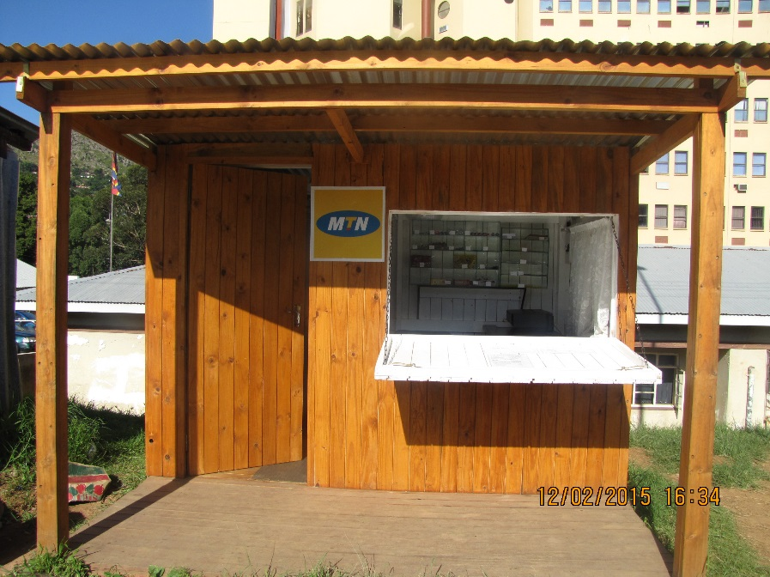
FINANCING LOCAL GOVERNMENT SERVICES- MUNICIPAL COUNCIL OF MBABANE
PRESENTATION BY : THULANI MAPHALALA

Slide 3
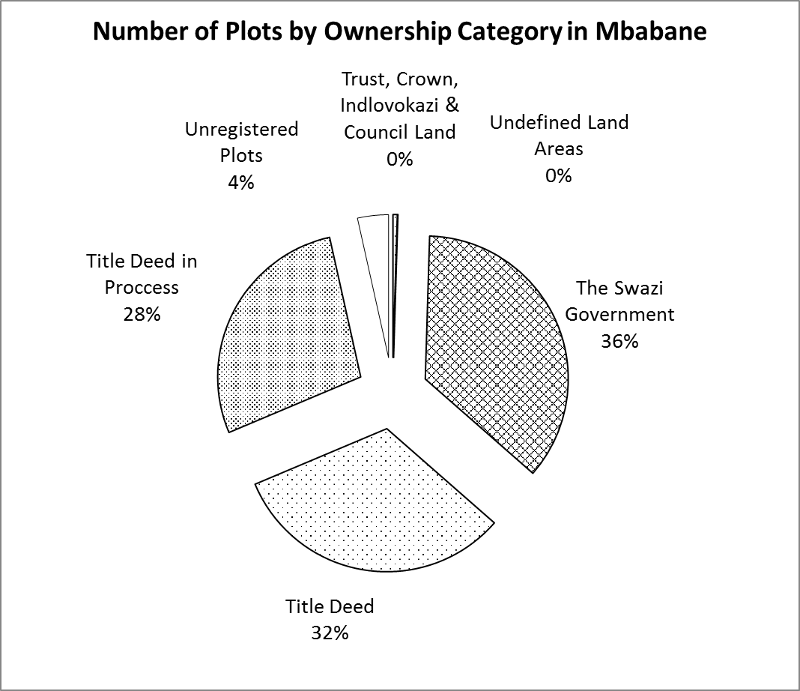

Slide 4
INTRODUCTION
In 2016 the Municipality conducted a baseline survey on land leasing in the city.
The Municipal Council of Mbabane has identified land as the single and most important resource through which it can promote development and influence or generate employment for the welfare of its people.
Section 65 of the Urban Government Act No. 8 of 1969
(3) The approval of the Minister shall not be required and shall not apply;
(a)In respect of a lease for a period not exceeding two years .
Above Legal framework defines ‘short term leasing,

Slide 5
LEASING OF LAND: CONDITIONS
Land shall be leased on a short-term basis (two years) subject to renewal.
Applicants for land lease should be aware that Council does not intend this to be in any way a route to the ultimate ownership of a site.
A person, individual, association or company shall express interest in acquiring land through the filling and submission of a land lease application form, for assessment of the application.
Only temporal structures will be allowed, and structures to be constructed will be subject.
Compliance with relevant Municipal legislation.
The primary considerations when determining the term of any lease are the nature and significance of the proposed permitted use and development under the lease.

Slide 6
LEASE CATEGORIES
66 short term
Leases
Medium- Businesses
Car Washes
Block yards
Concrete Pillars
Nurseries
Treated Poles
Small – Businesses
Clock rooms
Photocopiers
Tuck Shops
Fruit and vegies

Slide 7
CHALLENGES
Entitlement over land
Non compliance to building materials required.
Payments of rentals
Additional items than applied for.
Lack of diversity in business from applicants.
Land speculation

Slide 8
GOVERNMENT LAND FOR PUBLIC PRIVATE PARTNERSHIP
In Mbabane 36% of land belongs to Government. To improve Council leverage in the engagement of private developers it is desirable that the land parcels be transferred to council.
The Local Economic Development thrust has five pillars. One of these pillars is Public Private Partnerships (PPPs). Public Private Partnerships provide a means of cooperation between public and private sector for development and/ or operation of infrastructure and provision of services, help improve quality and efficiency of public services, provide the necessary resources to cover investment needs and also provide a means to harness private sector investment, in particular private finance and the related operational efficiencies in the provision of public assets and services.
PPPs at the local level are used as one of the avenues by local authorities to enhance their revenue base and strengthen their relationship with the private sector

Slide 9
EXAMPLES MUNICIPAL COUNCIL
OF MBABANE IS CURRENTLY WORKING ON

Slide 10
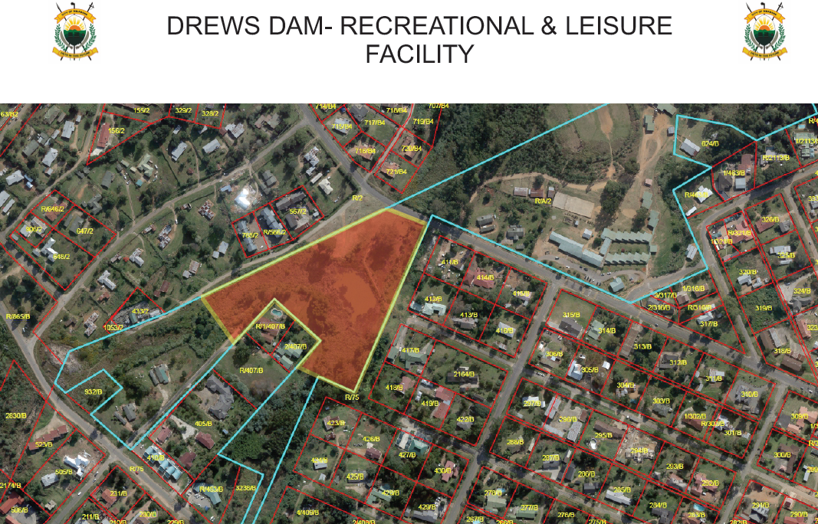
Examples

Slide 12
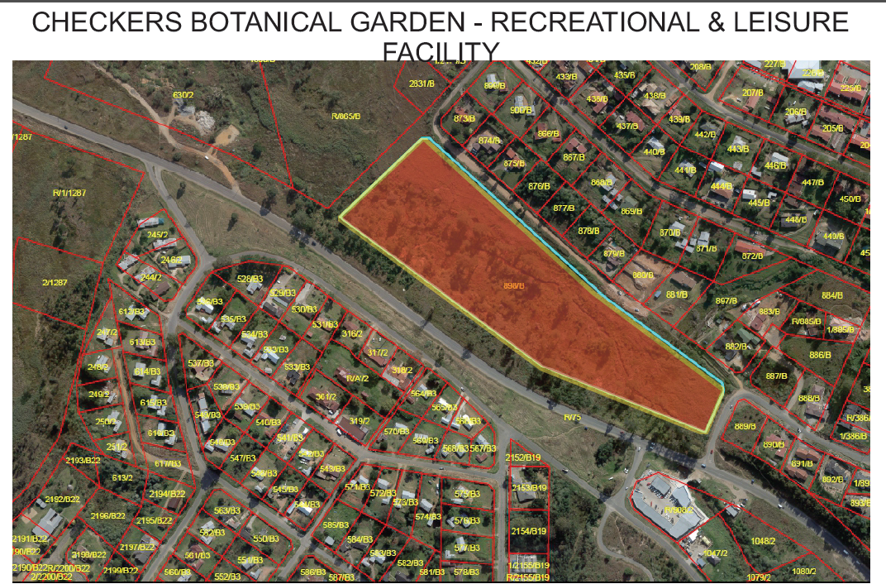

Slide 13
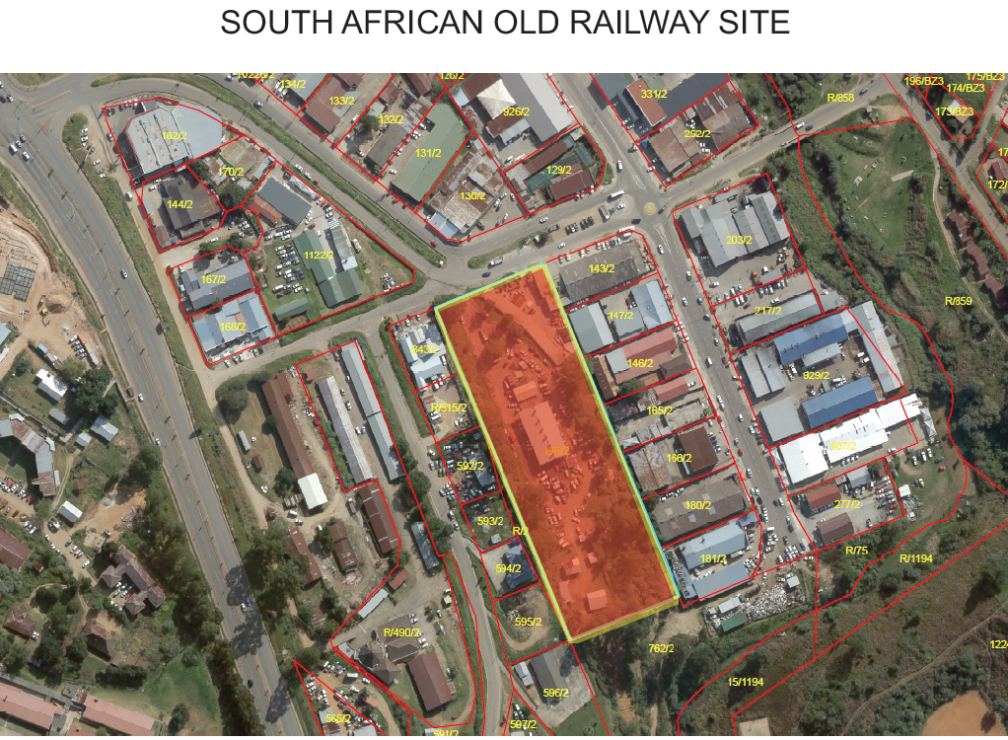

Slide 14
CHALLENGES
Long Land acquisition processes.
Lack of aligned spatial framework- central government and local authorities.

